Slide 1

CHAPTERONE
End-to-End DevOps, DevSecOps & GitOps Implementation
Microservices on Kubernetes with Helm, ArgoCD & Reusable GitHub Actions
DEVOPS
DEVSECOPS
GitOps
Gokul K
github.com/Googleeyy

Slide 2
PROJECT OVERVIEW & SCOPE
WHAT THIS IS
KEY PILLARS
Complete Library Management microservices platform on Kubernetes — 4 backend services + frontend + infrastructure.
DevOps scope: code commit → production deployment.
CI/CD with reusable GitHub Actions
Container security scanning (DevSecOps)
GitOps with ArgoCD
Helm-based Kubernetes packaging
7 GITHUB REPOSITORIES
Multi-environment namespace strategy
● ChapterOne — legacy/parent repository
● ChapterOne-Book — Java microservice
● ChapterOne-Borrow — Java microservice
● ChapterOne-User — Java microservice
● ChapterOne-Frontend — JavaScript frontend
● ChapterOne-Reusable-Templates — CI/CD workflows
● ChapterOne-Helm — Helm charts + ArgoCD + GitOps
Network security policies
02

Slide 3
ARCHITECTURE OVERVIEW — THE BIG PICTURE
DEVELOPER WORKFLOW
CI/CD PIPELINE
GitOps & KUBERNETES
1. Developer pushes code
2. GitHub PR created
3. Branch Protection Rules
4. CI Pipeline triggers
Repos: ChapterOne-Book, -Borrow, -User, -Frontend
▸ Build & Scan (Trivy)
▸ Push to Docker Hub
▸ Update Helm Chart
▸ Notify (Slack)
Reusable workflows: _build_trivy → _push → _update_helm → _notify
▸ ChapterOne-Helm Repo
▸ ArgoCD watches Git
▸ Auto-syncs to cluster
● library-dev namespace
● library-prod namespace
SERVICES DEPLOYED
book-service
:8081
user-service
:8082
borrow-service
:8083
frontend
:80
mongodb
StatefulSet :27017
gateway
KGateway
■ GitHub ■ CI/CD ■ Kubernetes
03

Slide 4
THE MICROSERVICES LANDSCAPE
4 BACKEND MICROSERVICES (JAVA/SPRING BOOT)
1 FRONTEND (JAVASCRIPT/REACT)
Book Service — Inventory management, CRUD operations on book records
User Service — Authentication & user management with JWT security
Borrow Service — Borrowing records, transactions, due-date tracking
Web UI consuming all backend APIs via Gateway routing
1 DATA LAYER
MongoDB StatefulSet with persistent volume (nfs-client StorageClass)
3 databases: chapterone_books, chapterone_users, chapterone_borrows
1 GATEWAY LAYER
KGateway (Gateway API) for ingress routing
HTTPRoute definitions: /api/books, /api/users, /api/borrows
HELM PACKAGING STRUCTURE
Each microservice has its own Helm subchart under microservices/ | Infrastructure charts (MongoDB + Gateway) under infrastructure/
04

Slide 5
HELM CHART ARCHITECTURE
"Chart of Charts" — Umbrella Pattern
library-e2e (Parent Chart)
Chart.yaml with 6 dependencies
book-service
borrow-service
user-service
frontend
mongodb
gateway
microservices/ (blue)
infrastructure/ (green)
VALUES HIERARCHY
1. Environment Overrides — values-dev.yaml / values-prod.yaml (highest priority)
2. Parent Defaults — values.yaml (parent chart defaults)
3. Subchart Defaults — microservices/*/values.yaml
4. Internal Defaults — Subchart internal defaults (lowest priority)
Key Design: Global namespace propagation — global.namespace set at parent level flows to all subcharts
values-dev.yaml → library-dev namespace | values-prod.yaml → library-prod namespace
05

Slide 6
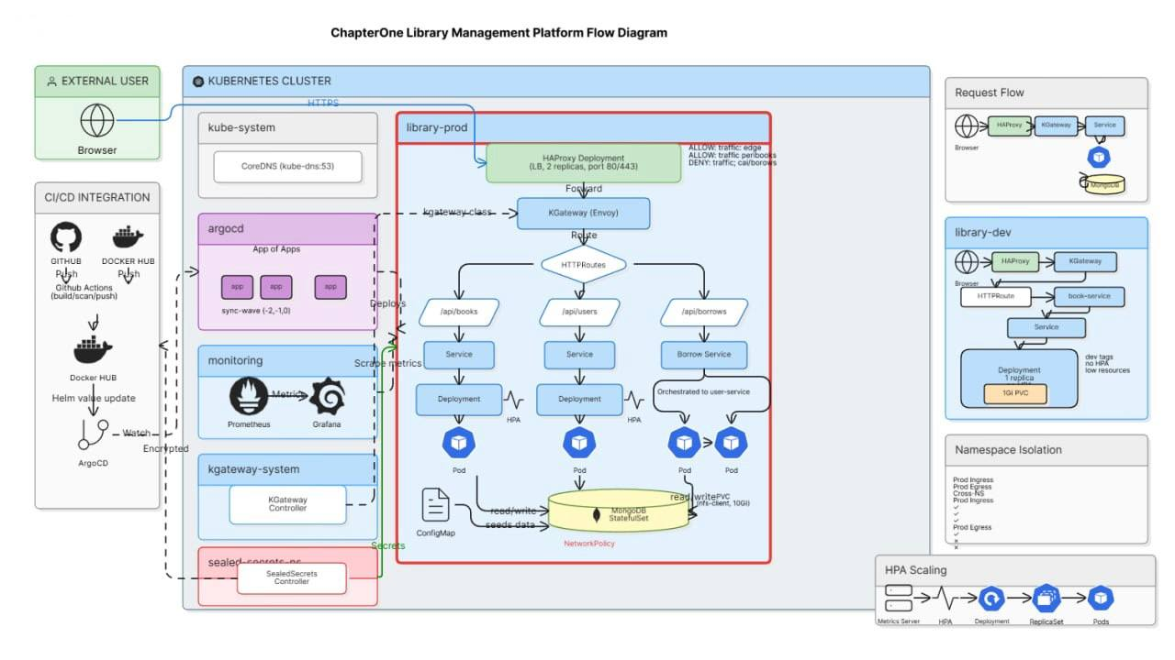
05

Slide 7
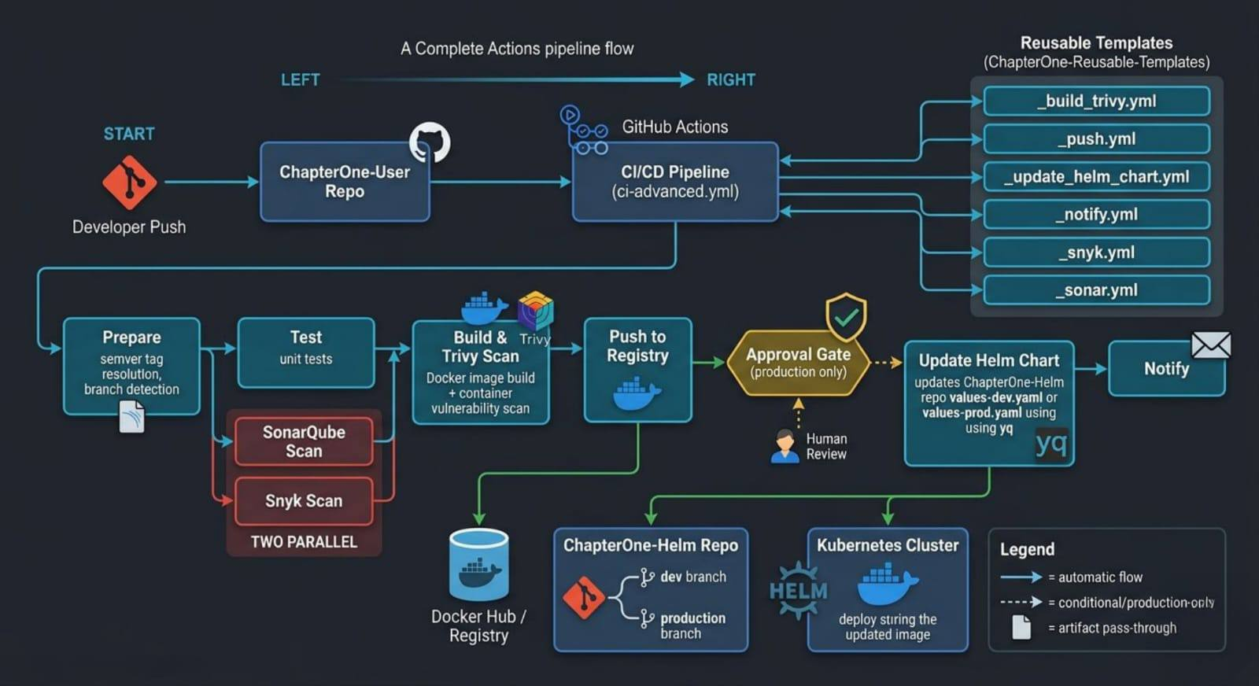

Slide 8
ENVIRONMENT STRATEGY
Namespace Separation — Dev vs Production
Aspect | Development (library-dev) | Production (library-prod)
Replicas | 1 per service | 3 per service (HPA 3-10)
MongoDB Storage | 1Gi | 10Gi
Resource Limits | 250m CPU, 256Mi mem | 500m CPU, 512Mi mem
Autoscaling | Disabled | Enabled (CPU 70%, mem 80%)
Image Tags | dev-<commit-sha> | Semantic (v1.0.0)
Network Policies | Optional / Light | Enforced
JWT Secret | Weak placeholder | Strong secret (must rotate)
BRANCH MAPPING
ISOLATION
dev branch → library-dev namespace
production branch → library-prod namespace
Complete logical separation at Kubernetes API level
within the same cluster
06

Slide 9
GITHUB ACTIONS — REUSABLE WORKFLOWS
Centralized CI/CD Hub: ChapterOne-Reusable-Templates | Pattern: workflow_call
Docker Hub: googleyy/<service-name>
Workflow File | Purpose | Trigger
_build_trivy.yml | Build Docker image + Trivy vulnerability scan | Called by service CI
_push.yml | Push image to Docker Hub + Git tag (prod) | Called after build
_update_helm_chart.yml | Update image tag in Helm repo values file | Called after push
_snyk.yml | Snyk dependency vulnerability scan | Standalone or called
_sonar.yml | SonarQube code quality analysis | Standalone or called
_notify.yml | Slack deployment notifications | Final step
BENEFITS
● DRY principle — one workflow definition, used across 4+ microservices
● Centralized maintenance — update in one place, all repos get the fix
● Consistent security scanning — every service gets identical Trivy, Snyk, and SonarQube gates
07

Slide 10
CI/CD PIPELINE DEEP DIVE
STAGE 1: BUILD & SCAN
STAGE 2: PUSH
STAGE 3: UPDATE HELM
STAGE 4: NOTIFY
_build_trivy.yml
_push.yml
_update_helm_chart.yml
_notify.yml
Runtime
Java 21 Temurin / Node 20
Build
mvn package -DskipTests
Docker
Build with cache optimization
Trivy Scan
CRITICAL,HIGH threshold
Artifact
Upload image (1-day retention)
Output
image_full registry path
Download
Load artifact image
Push to Registry
Docker Hub with commit SHA tag
Production Only
Tag and push "latest"
Create Git tag
Conditional
is_production=true
push_dev_images=true
Checkout
ChapterOne-Helm at correct branch
Setup yq
YAML processor
Transform
kebab → camelCase
book-service → bookService
Update Values
values-dev.yaml or values-prod.yaml
Commit
github-actions[bot]
HELM_REPO_PAT auth
Slack Webhook
Deployment status notification
Summary
Success/failure status
Environment name
Service name
08

Slide 11
DEVSECOPS — SECURITY SCANNING MATRIX
Security Layer | Tool | What It Scans | Threshold | When It Runs
Container Vulns | Trivy | Docker image OS/packages | CRITICAL, HIGH | Every build
Dependency Vulns | Snyk | Maven/npm dependencies | Configurable (high) | Every build or on-demand
Code Quality | SonarQube | Source code, smells, coverage | Quality Gate | Every build
Network Segmentation | NetworkPolicy | Pod-to-pod traffic | Namespace isolation | Deploy-time
Secrets Mgmt | K8s Secrets | JWT, DB credentials | In-cluster only | Deploy-time
TRIVY DETAILS
SNYK DETAILS
SONARQUBE DETAILS
● Scans built Docker images before push
● Severity filter: CRITICAL, HIGH
● Table output + SARIF format
● GitHub Security tab integration
● ignoreUnfixed flag for FP control
● Maven: snyk test --severity-threshold=high
● Node: Snyk GitHub Action
● Uploads SARIF artifact
● Audit trail for compliance
● Java: mvn verify sonar:sonar
● Node: SonarSource GitHub Action
● Code quality analysis
● Duplication detection
● Coverage reporting
09

Slide 12
GitOps WITH ARGOCD — "GIT AS SOURCE OF TRUTH"
ARGOCD INSTALLATION
INDIVIDUAL APPLICATIONS
● Helm chart from argo/argo-cd repository
● Custom values: NodePort 30080
● Resource limits for small clusters
● Dex disabled
● Namespace: argocd
One Application per service:
book-service, borrow-service, user-service,
frontend, mongodb, gateway
● Sync-wave annotations for ordering
● sync-wave: "0" for microservices
● Higher waves for infrastructure deps
ARGOCD CONFIGURATION
SYNC POLICY
AppProject: library-e2e
Defines allowed source repos and destination namespaces
App of Apps Pattern:
● library-root (dev) → watches argocd-apps/ on dev branch
● library-root-prod → watches argocd-apps-prod/ on production branch
● directory: recurse: true (auto-discovers manifests)
● automated: prune: true, selfHeal: true
● CreateNamespace = true
● ServerSideApply = true
● revisionHistoryLimit: 3
Retry Policy:
● 3 attempts with exponential backoff
● 5s → 10s → 20s
10

Slide 13
GitOps FLOW — DEVELOPER TO PRODUCTION
PATH 1: DEVELOPER → DEV ENVIRONMENT
PATH 2: PROMOTE TO PRODUCTION
1. Developer pushes feature branch → merges to dev
2. Service CI triggers → _build_trivy.yml → _push.yml
3. _update_helm_chart.yml updates values-dev.yaml
4. ArgoCD detects commit (polls every 3 min)
5. ArgoCD runs helm template with values-dev.yaml
6. Kubernetes applies to library-dev namespace
7. New pods roll out (1 replica, dev image tag)
1. Create PR from dev → production
in ChapterOne-Helm repository
2. Merge triggers or manual promotion
3. ArgoCD detects commit on
production branch
4. Syncs to library-prod namespace
5. Production pods roll out:
● 3 replicas per service
● HPA enabled
● TLS termination on
● Semantic version tags
Key Principle: No human runs helm upgrade or kubectl apply. ArgoCD is the ONLY actor touching cluster state.
11

Slide 14
KUBERNETES NETWORK SECURITY
CONCEPT
OUR IMPLEMENTATION
Kubernetes NetworkPolicy acts as a namespace firewall — controlling which pods can communicate with each other at the network level.
Lightweight permissive policy:
✓ Allow all intra-namespace traffic
✓ Allow DNS resolution (port 53)
✓ Allow MongoDB access (port 27017)
✗ Block cross-namespace traffic
Dynamic: uses {{ .Values.global.namespace }}
DYNAMIC & SCOPE
● Dev: applies to library-dev
● Prod: applies to library-prod
● Scope: All pods in namespace (podSelector: {})
REAL-WORLD USE CASES
DEFENSE IN DEPTH
Multi-tenant SaaS, microservices segmentation, zero-trust architecture, compliance (SOC2, GDPR)
NetworkPolicy + Image Scanning + RBAC + Secrets Management + Runtime Security = layered security
12

Slide 15
SEALED SECRETS — GIT-SAFE ENCRYPTION
KUBERNETES SECRETS DEFINED
DEV VS PRODUCTION
●Kubernetes Secrets are only base64-encoded — not encrypted.
● SealedSecret encrypted for library-prod cannot be decrypted in library-dev or default. This prevents accidental secret leakage across environments.
borrow-service-secret — service credentials
Development:
JWT_SECRET: "dev-jwt-secret-not-for-production"
Production:
Sealed Secrets
ArgoCD syncs the `SealedSecret` → Controller decrypts → creates native `Secret` automatically
Each service has its own ConfigMap for non-sensitive config
PRODUCTION ENVIRONMENT
● Sealed Secrets (Bitnami) — encrypt secrets for Git storage
● External Secrets Operator — integrate with cloud KMS
● HashiCorp Vault — dynamic secrets and secret rotation
● Regular secret rotation — automated credential lifecycle
MongoDB Init ConfigMap: seeds database with 20 sample books on first startup
13

Slide 16
BRANCH PROTECTION & GOVERNANCE
BRANCH STRATEGY
BRANCH PROTECTION RULES
dev branch — Active development, auto-deploy to dev environment
production branch — Protected, deploys to production only
● Require PR before merging
● Require 1 approval minimum
● Dismiss stale approvals on new commits
● Require status checks (helm-validate)
● Block force pushes
● Restrict push access to admins
HELM VALIDATION WORKFLOW
● Runs on every PR to dev and production
● Validates YAML syntax with yq
● Lints all subcharts with helm lint
● Dry-run with values-dev.yaml and values-prod.yaml
THE CD BYPASS
Automated _update_helm_chart.yml pushes directly using PAT — this is intentional for CI/CD automation.
Human changes must always go through PRs with required reviews and status checks.
14

Slide 17
MONITORING, OPERATIONS & ROLLBACK
OPERATIONS WITH ARGOCD
HELM ROLLBACK (NATIVE)
argocd app list — View all app statuses
argocd app get <app> — Sync status
argocd app sync <app> — Manual sync
argocd app history <app> — History
argocd app rollback <app> <rev> — Rollback
helm history library-dev -n library-dev
View revision history
helm rollback library-dev -n library-dev
Rollback to previous revision
TROUBLESHOOTING
● Pod logs, describe, events
● Service endpoints and DNS resolution
● Network policy verification with test pods
● PVC status for MongoDB
GitOps ADVANTAGES FOR OPERATIONS
● Complete audit trail in Git — who changed what, when, with full history
● Declarative state — cluster always matches Git, drift is impossible
● Self-healing — ArgoCD reverts any manual cluster changes automatically
● Pruning — removes resources not defined in Git, preventing resource leaks
15

Slide 18
COMPLETE TOOLCHAIN & TECHNOLOGIES
Layer | Technology | Purpose
Orchestration | Kubernetes | Container orchestration and scheduling
Package Manager | Helm 3 | Kubernetes manifest templating and packaging
GitOps | ArgoCD | Continuous delivery from Git — cluster state sync
Gateway | KGateway | Gateway API for ingress and path-based routing
Database | MongoDB | Document storage (StatefulSet with persistence)
Storage | nfs-client | StorageClass for persistent volumes
CI/CD | GitHub Actions | Build, test, deploy automation with reusable workflows
Registry | Docker Hub | Image storage (googleyy/* organization)
Security Scan | Trivy | Container vulnerability scanning (CRITICAL, HIGH)
Dependency Scan | Snyk | Dependency vulnerability scanning (Maven, npm)
Code Quality | SonarQube | Static analysis, code smells, coverage
YAML Processing | yq | Automated values file editing in CI pipeline
Version Control | Git + GitHub | Source of truth for code and configuration
16

Slide 19
KEY ACHIEVEMENTS & METRICS
MULTI-REPO CI/CD
ZERO MANUAL CLUSTER ACCESS
SECURITY GATES
ENVIRONMENT PARITY
4 microservices + frontend sharing identical reusable GitHub Actions workflows
All deployments automated via GitOps — no human kubectl or helm upgrade on cluster
3 scanning tools in every pipeline: Trivy, Snyk, and SonarQube
Same Helm chart, different values files — guaranteed parity
SUB-MINUTE ROLLBACK
NAMESPACE ISOLATION
SCALABILITY READY
DOCUMENTATION
Rollback via Git revert or ArgoCD history — under 60 seconds
Complete dev/prod separation within a single cluster
HPA configured (3-10 replicas) for production workloads
6 comprehensive guides covering all aspects of the platform
17

Slide 20
LESSONS LEARNED & BEST PRACTICES
Reusable workflows reduce maintenance burden and ensure consistent security scanning across every service pipeline.
GitOps eliminates "it works on my machine" — Git IS the deployment state. The cluster simply reflects what's in the repo.
Parent-level values files are superior to subchart defaults for environment management — one place to change per environment.
Branch protection on production prevents accidental configuration changes — the cost of a bad deploy far exceeds review friction.
App of Apps pattern scales cleanly — adding a new service requires only one new YAML file in the apps directory.
Automated Helm chart updates bridge CI (build) and CD (deploy) seamlessly — no manual handoffs between pipeline stages.
Network policies should start lightweight, then be tightened based on actual observed traffic patterns — not guessed.
Trivy + Snyk provide defense in depth — scanning both containers AND dependencies catches different vulnerability classes.
18

Slide 21
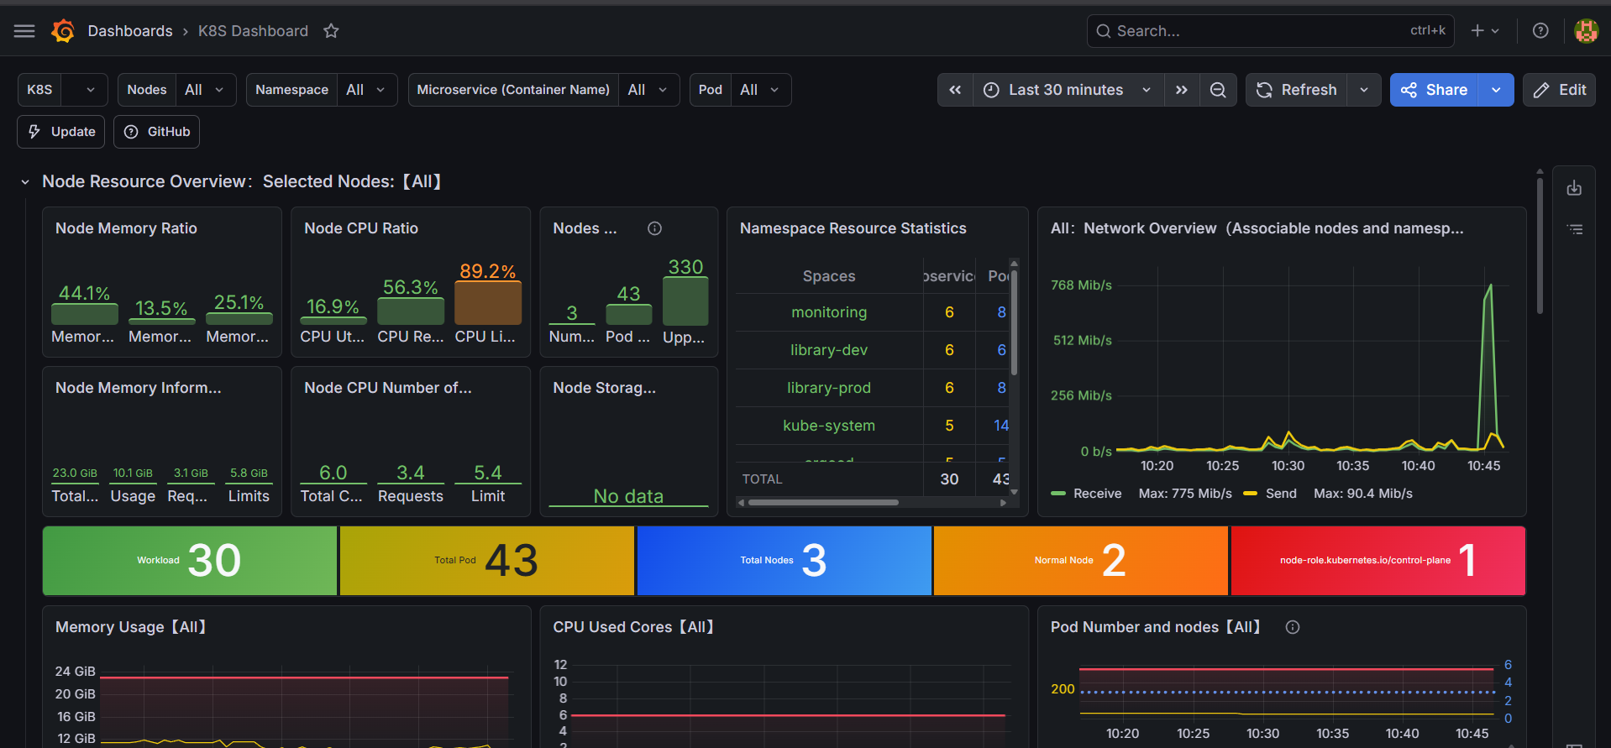

Slide 22
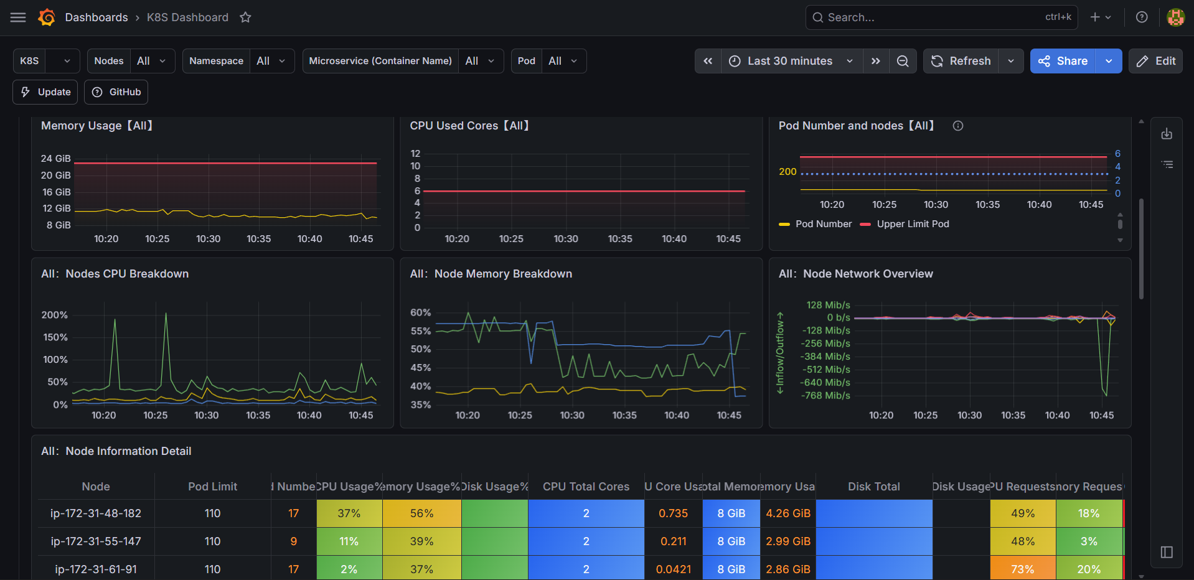

Slide 23
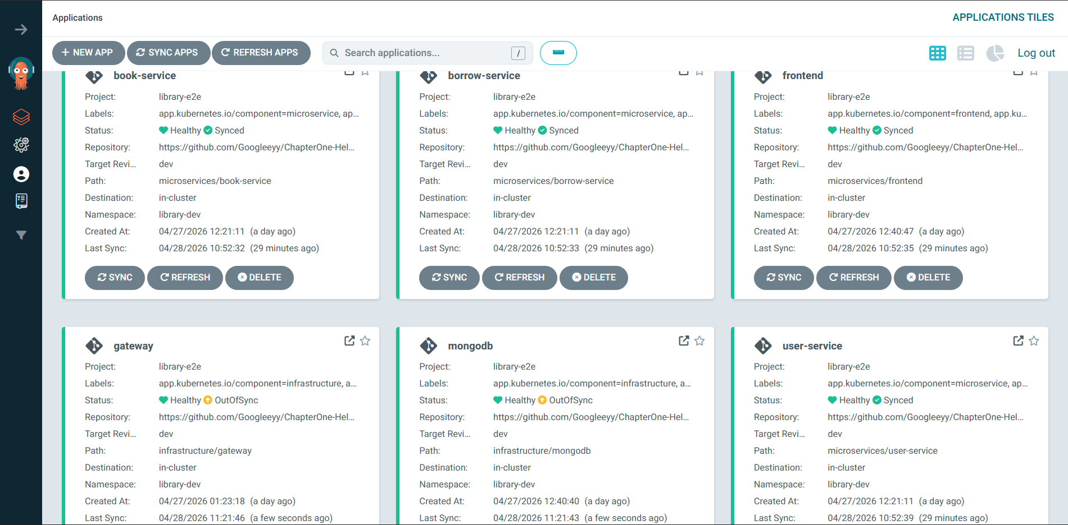

Slide 24
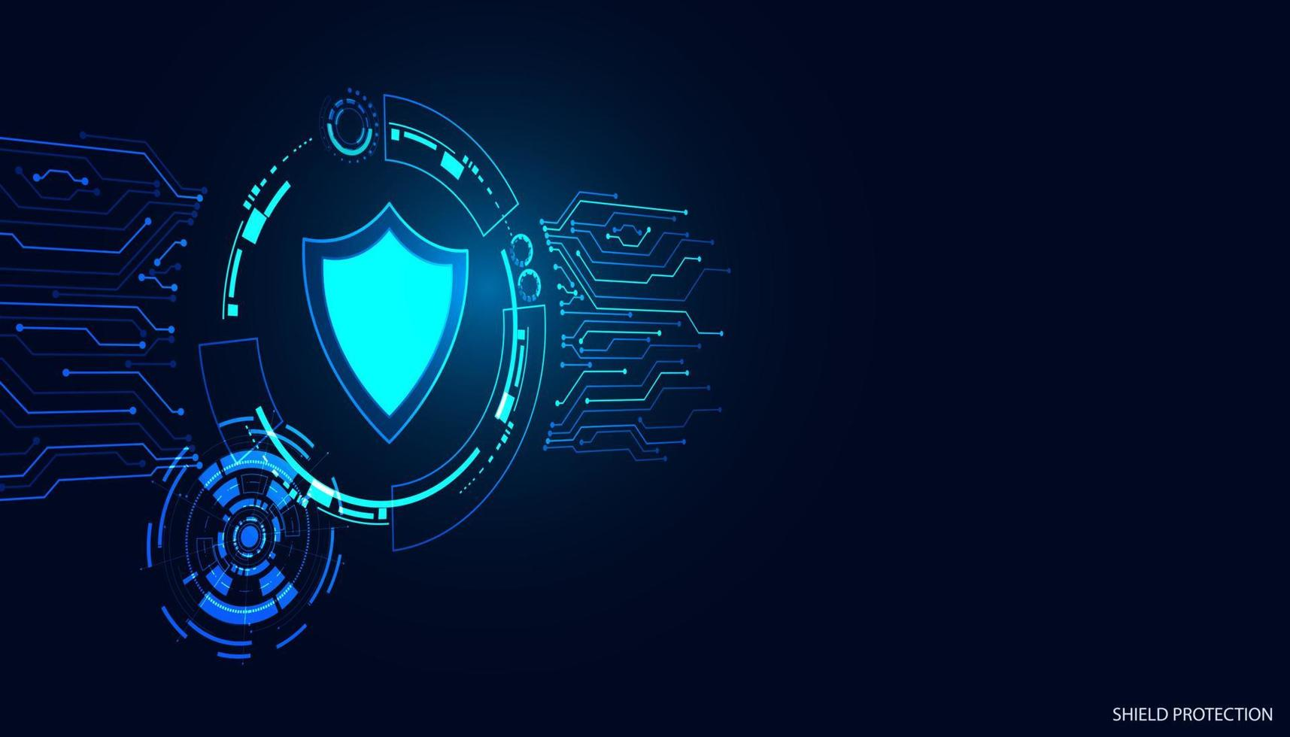
Q & A
This platform demonstrates production-grade DevOps practices:
automated pipelines, security-first scanning, GitOps delivery,
and comprehensive documentation — ready to scale.
github.com/Googleeyy
DEVOPS • DEVSECOPS • GitOps • KUBERNETES

